Slide 1
Stevens - Pond Hill PTO Meeting
September 17, 2025

Slide 2
Agenda
01
02
03
04
Welcome to the PTO!
Budget
Meet Board Members & Principals
Upcoming Events
Meeting Schedule & Communication

Slide 3
The 2025-2026 PTO Board
President ~ Kathleen Daly
Vice President ~ Greg Eng
Co-Recording Secretary~ Nicole Castelli
Co-Recording Secretary ~ Ashley Myers
Co-Recording Secretary ~ Charity Singer
Treasurer ~Jessica Panzarella
Fundraising Co-Chair ~ Theresa Kingston
Fundraising Co-Chair ~ Molly Whitehouse
Volunteer Coordinator ~vacant
Publicity - Lead ~ Ali Greenfield
Hospitality Chair ~ Leah Migilore

Slide 4


Principal’s Report

Slide 5
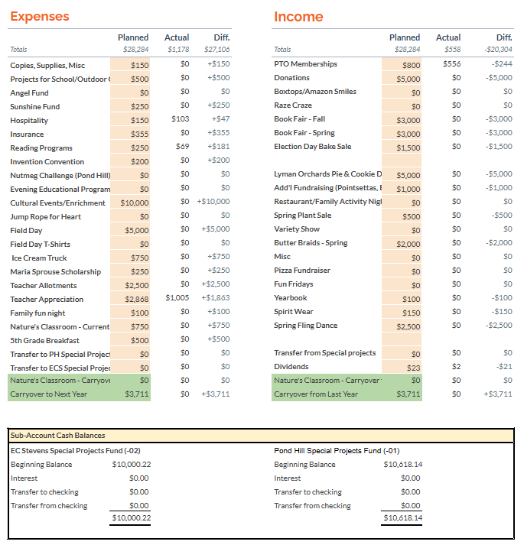
Treasurer's Report
August Meeting Minutes

Slide 6
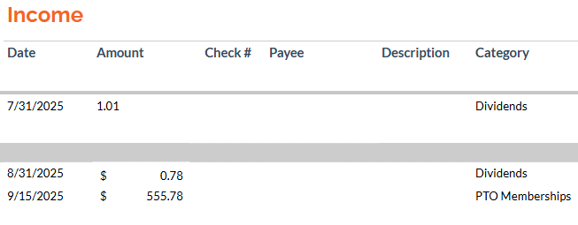
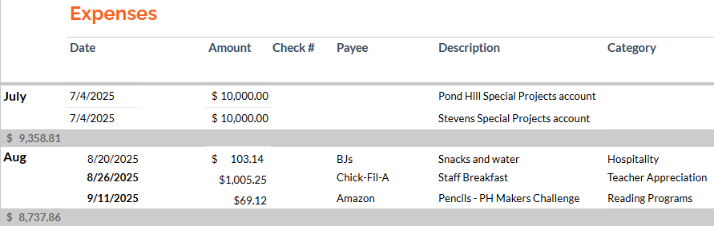

Slide 7
Last Month’s Events
August Pre-K/Kindergarten Meet & Greet 8/22 Staff Welcome Breakfasts 8/25
September ECS Open house 9/9 PH Open House 9/11

Slide 8
Upcoming Events
September Ice Cream Social 9/19 Scholastic Book Fair 9/29-10/2 Beaumont Fundraiser 9/15-10/31 Lyman Orchards Pie Fundraiser 9/23-10/4
October Trunk or Treat 10/17 Spirit Wear- 10/20-11/07

Slide 9



Slide 10

Current openings:
ECS: Tues 9/30/25:
11-1 1 spot and 1-3 3 spots
PH: Wed 10/1/25:
9-11- 2 spots
11-1 2 spots
1-3 1 spot
E.C. Stevens
Tuesday September 30 9am-3pm
Thursday October 2 9am-3pm
Pond Hill
Monday September 29 9am-3pm
Wednesday October 1 9am-3pm

Slide 11


Slide 12
Questions, comments, suggestions?

Slide 13

Next PTO Meeting:
October 15th 6:30 pm

